Slide 1
Competitive Cyber Security Organization
General – System Hardening
By attending today’s meeting you acknowledge that you may be photographed or recorded for club use

Slide 2
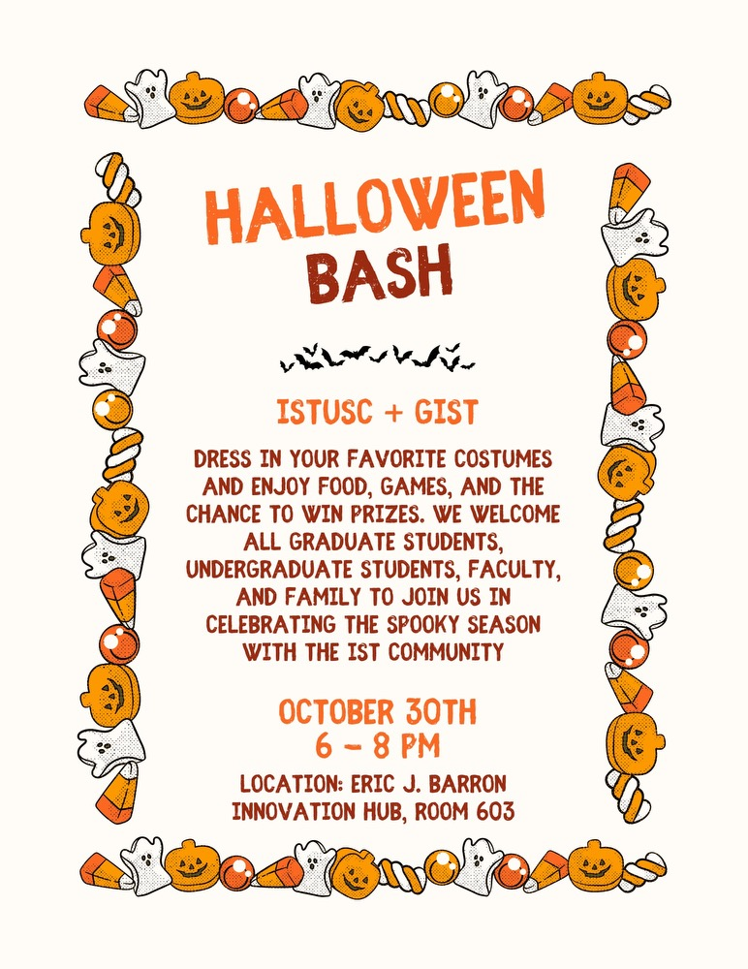
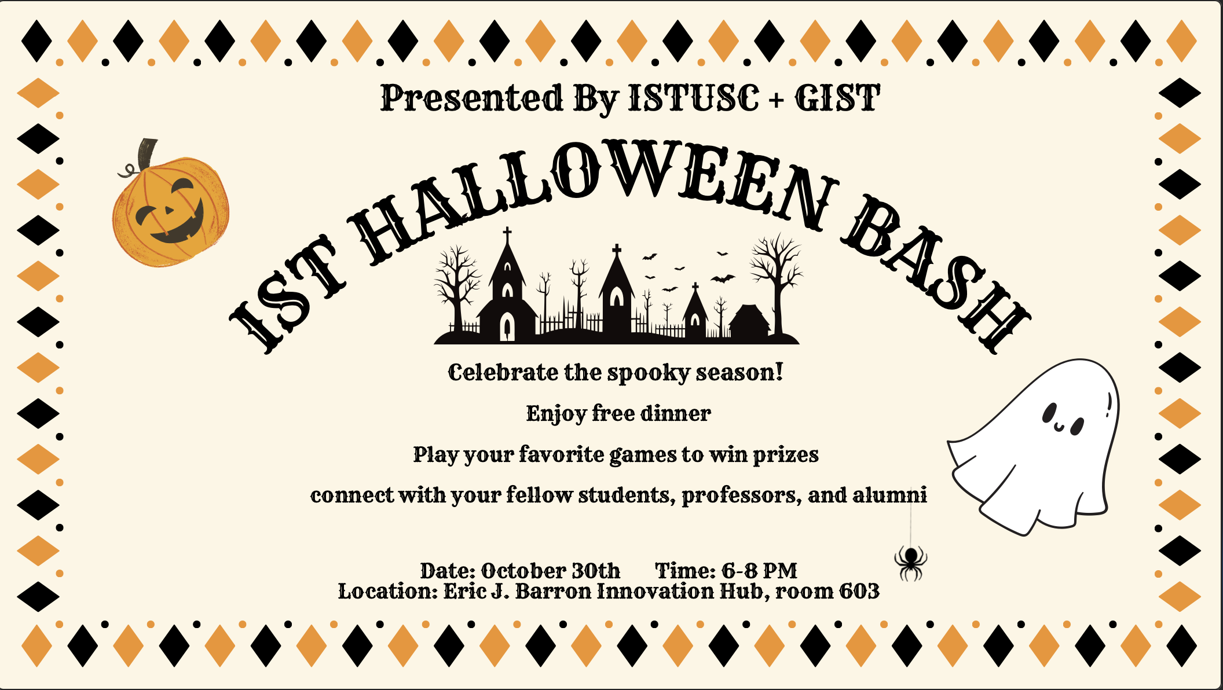


Slide 3
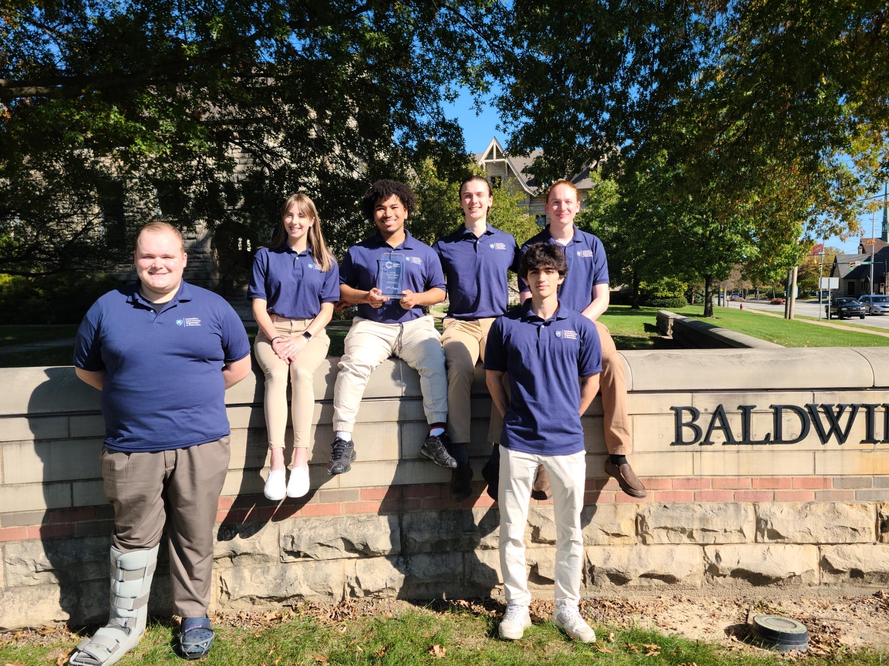
Competition Results!!
Hivestorm Standouts:
Placed 9th out of 413 teams (top 2%) - Cy Fisher(Captain), Ryan Zanoni, Mohammed Al Amri, and Walker Kennedy
Placed 35th out of 413 teams (top 10%) - Evan Glickman(Captain), Kevin Lytvynov, Ethan Jaslar, and Jacob Dorchinsky
CPTC – 2nd Place
Jonathan Skeete(Captain), Liam Geyer, Jenna Fox, Asa Reynolds, Maguire Younes, Robbie Roderick, and alternates: Bailey Milanovich and Cy Fisher

Slide 4
Learning Objectives:
General Hardening Best Practices
Specific to CCDC
Practice

Slide 5
Passwords
Complexity
Length
Age
Min/Max
Remember
Changing Passwords!!
Script
Notes:
Change user password

Slide 6
Users and Groups
Who is supposed to be on the system?
Who has the correct access?
Should have the following users:
User
PersonA
PersonB
Only User should be an admin

Slide 7
Updates
System Updates
App Updates
Auto Updates
Notes:
Explain apt-get update and apt-get upgrade

Slide 8
Ports/Services
Unnecessary ports and services running
Where are they running from?
Service Configuration
lsof
Ps
Sshd_config/RDP
Crontab/Task Scheduler
Notes:
Lsof -i –P –n, to find nc running
Ps awfux | grep <pid> -A 5 –B 5, find file path

Slide 9
Firewalls
Are they running?
UFW & Defender
Pay attention to what you block
Don't screw yourself
Check status
Turn on UFW
Set Rules

Slide 10
Incident Response
Check who's logged in
Remove them
Kill processes
CHANGE PASSWORDS!!

